Slide 1

Digital Signature
Presented By
Marwa Ali
Khizra Khan
Nabila Naz

Slide 2

What is a Digital Signature?
A digital signature is a cryptographic technique used to verify the authenticity and integrity of a digital message, document, or software. It provides a way for the recipient of a message to confirm that the message was indeed created by the claimed sender and that it hasn't been altered or tampered with since it was signed.
Here's how digital signatures typically work
Key Generation
Signing
Verification

Slide 3

Why Use Digital Signatures?
Integrity
Security
Authentication
Non-Repudiation

Slide 4
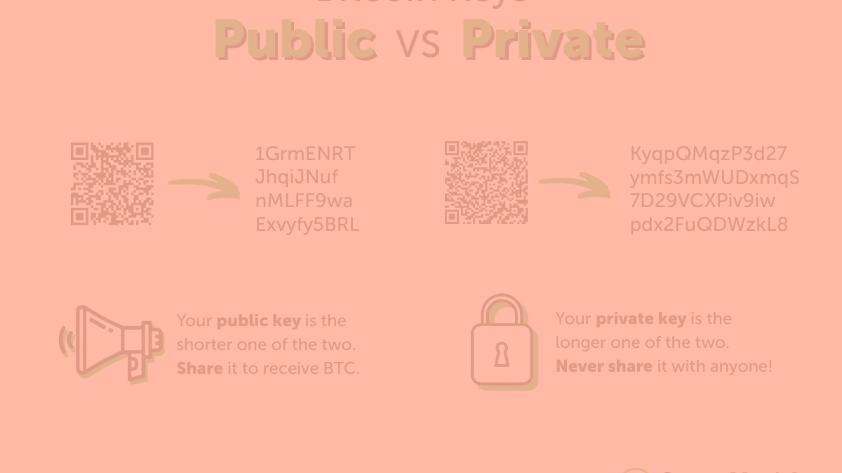
The Key Components
Public Key
Private Key
Digital Signature Certificate
The public key is made available to all those who receive the signed messages from the signer. It is used to verify the received message by decrypting the digital signature.
The private key is accessible only to the signer and is used to generate the digital signature, which is then attached to the message.
The digital signature certificate is issued by a trusted third-party entity, which allows the recipient of a message to prove that the message was indeed sent by the subscriber of the key pair.

Slide 5
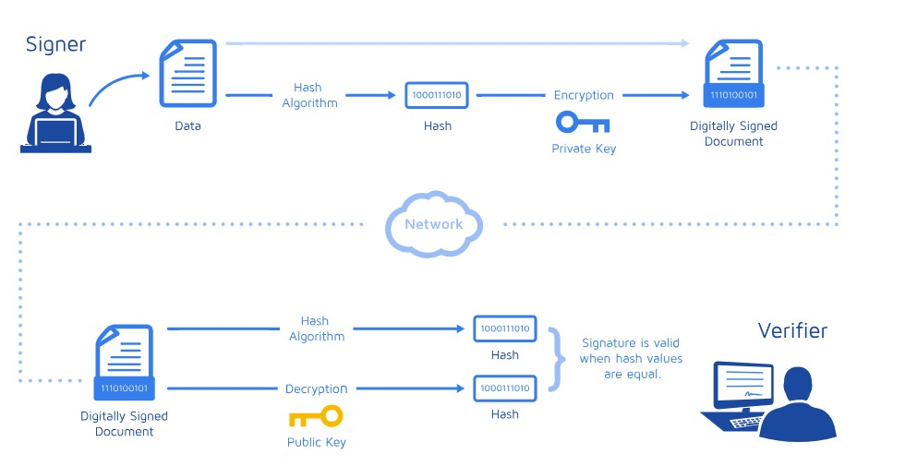
How Digital Signature Work

Slide 6

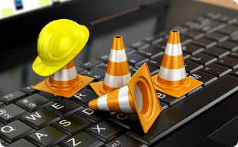


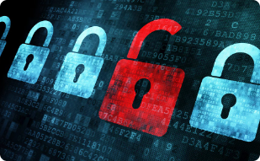
Potential Drawbacks
Technology Challenges
Security Concerns
Usability Barriers
Long-term Security

Slide 7



Specialized Applications
Blind Signatures
ISDN Networks
Blind signatures are a specialized form of digital signature that allows a signer to sign a message without knowing its content, often used in privacy-sensitive applications like anonymous voting and digital cash systems.
In telecommunications, digital signatures can be used in ISDN networks to authenticate and secure data transmission between network endpoints, ensuring the integrity and confidentiality of voice, video, and data communication.

Slide 8




Applications of Digital Signatures
Electronic Mail
Data Storage
Software Distribution
Ensure the authenticity and integrity
Databases, cloud storage, and file systems
integrity of data.
Authenticity
integrity
protection

Slide 9
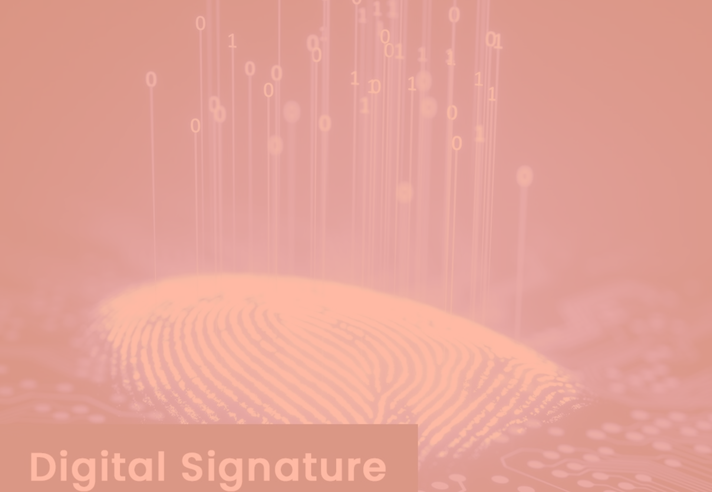
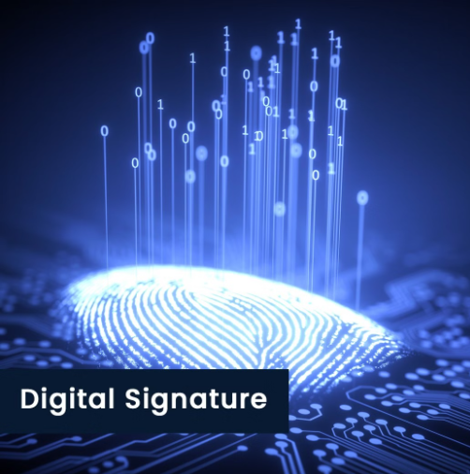
The Future of Digital Signatures
Evolving Security
1
As technology continues to advance, the security measures surrounding digital signatures will need to evolve to keep pace with emerging threats and vulnerabilities.
2
Increased Adoption
The widespread adoption of digital signatures is expected to continue, as they become more integrated into various industries and applications, providing a secure and efficient alternative to traditional handwritten signatures.

